Slide 1

Netflix Overview Dashboard
An in-depth look at the diverse content available on Netflix, spanning various genres, ratings, and geographical distributions.

Slide 2
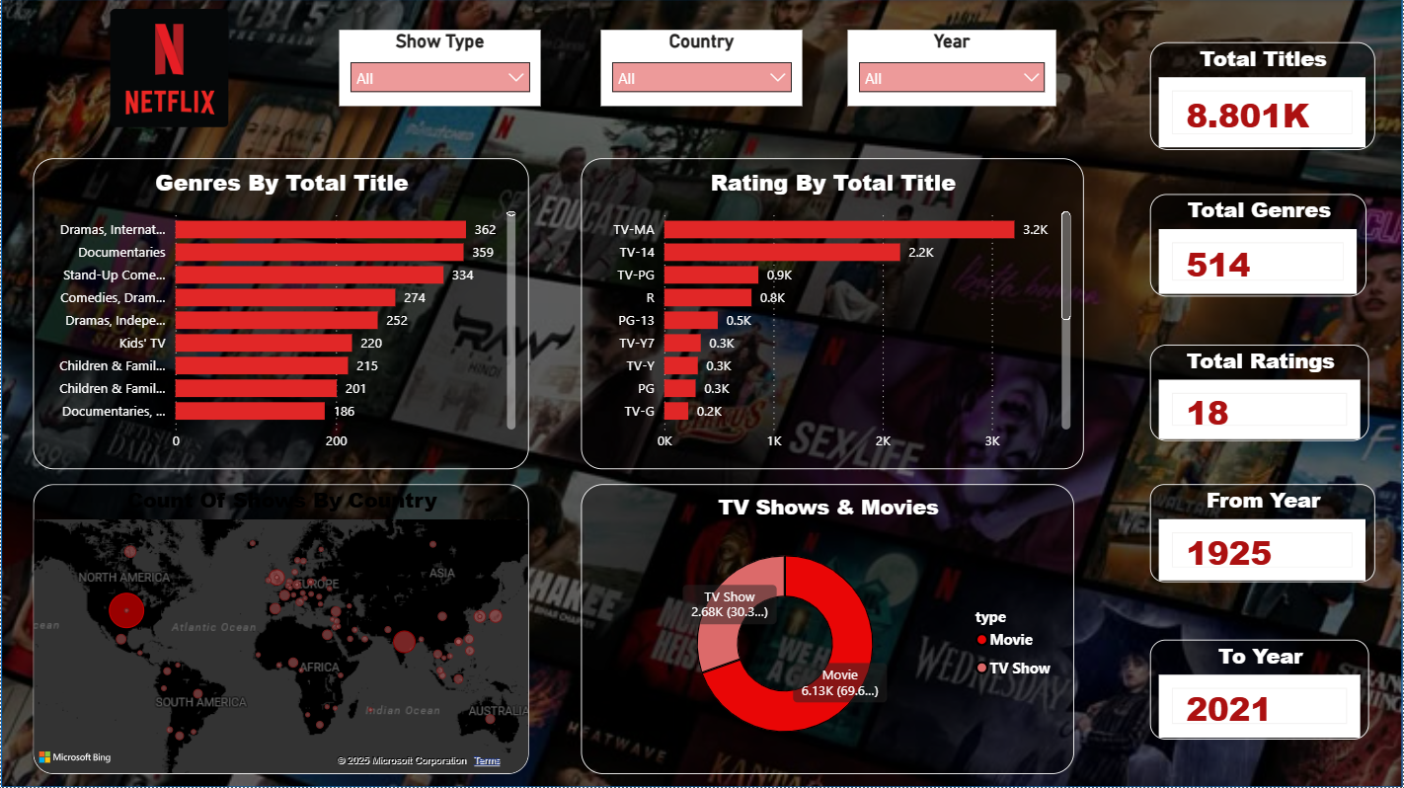

Slide 3

Total Titles & Content Types
8.8K
Total Titles
A vast library of movies and TV shows for every viewer.
Movies
TV Shows
Movies dominate the platform, making up nearly 70% of the total content.

Slide 4
Top Genres by Title Count
362
359
334
Dramas, International
Documentaries
Stand-Up Comedy
274
252
Comedies, Dramas
Dramas, Independent
Netflix offers a rich variety of genres, with dramas and documentaries leading the count.

Slide 5



Diverse Content Categories
Kids' TV
Children & Family Movies
220 titles
215 titles
Children & Family TV
Documentaries, International
201 titles
186 titles
Beyond the top categories, Netflix caters to niche audiences, including a strong focus on family-friendly and international documentary content.

Slide 6
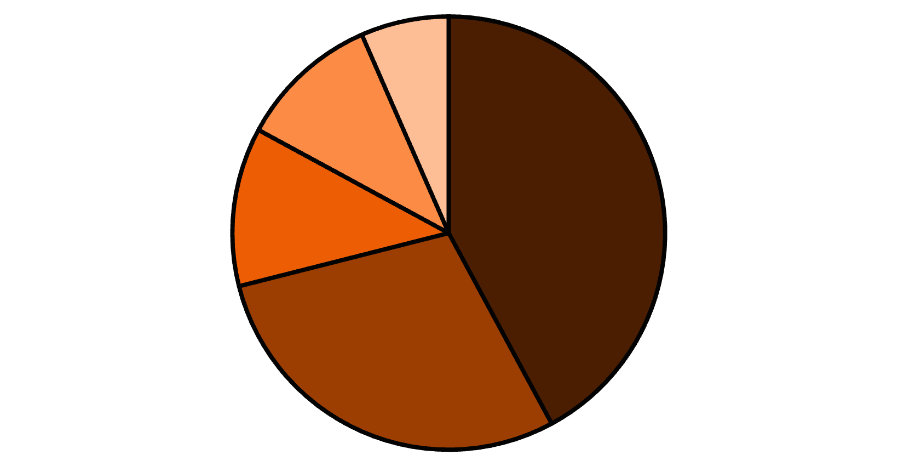
Ratings Distribution
TV-MA Dominates
The majority of Netflix content is rated TV-MA, indicating a strong focus on mature audiences.
TV-MA: 3.2K titles
TV-14: 2.2K titles
TV-PG: 0.9K titles
R: 0.8K titles
TV-MA
TV-14
TV-PG
R
PG-13
PG-13: 0.5K titles

Slide 7


Family-Friendly Ratings
0.3K
0.3K
TV-Y7
TV-Y
Content suitable for children aged 7 and up.
Content suitable for all young children.
0.3K
0.2K
PG
TV-G
Parental guidance suggested for younger viewers.
General audience content, suitable for all ages.
Netflix also provides a significant collection of content for younger audiences, ensuring options for every family member.

Slide 8
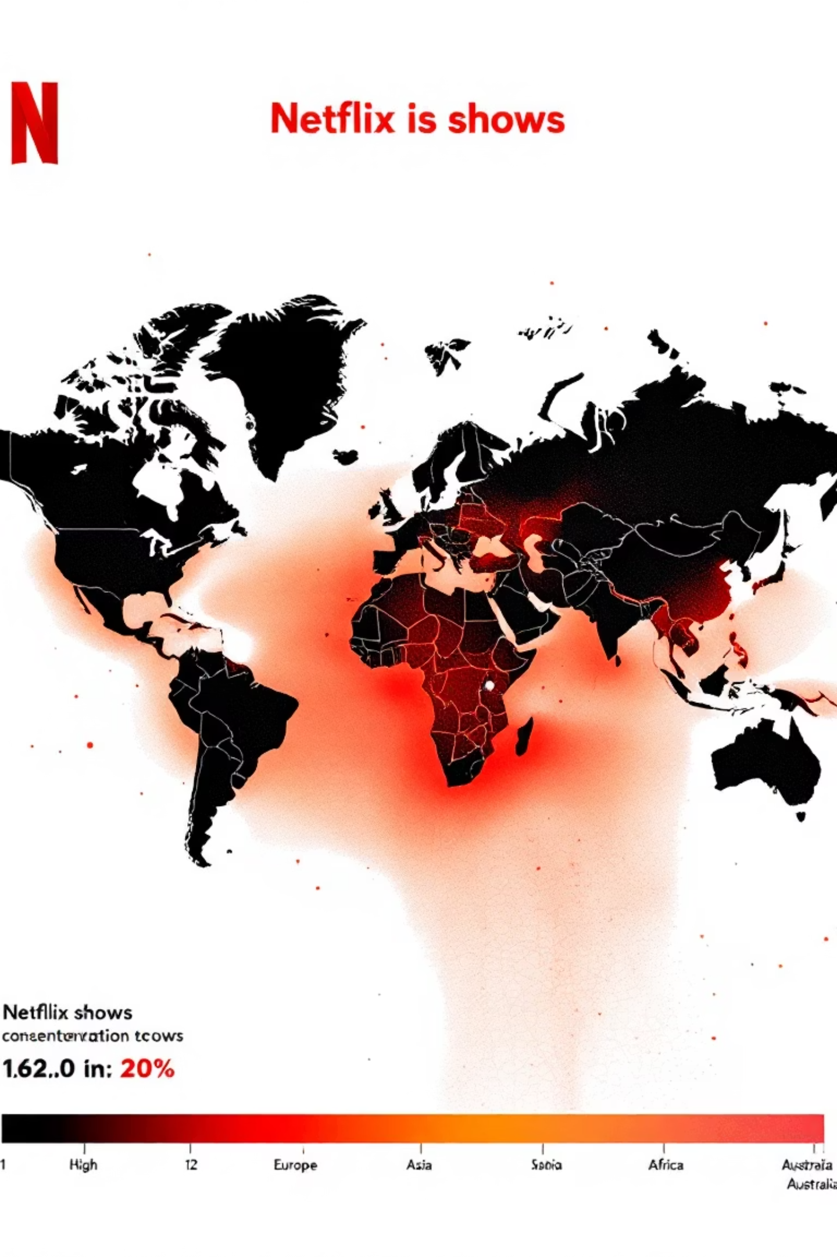
Global Content Distribution
The world map illustrates the distribution of Netflix shows by country, with North America showing the highest concentration.

Slide 9
Content Production Timeline
Early Beginnings
1
Content from as early as 1925 is available on the platform.
2
Modern Era
The content library extends up to the year 2021, showcasing recent productions.
Netflix's content spans nearly a century, offering a rich historical archive alongside contemporary releases.

Slide 10

Total Genres & Ratings
514
18
Total Genres
Total Ratings
A vast array of categories to explore.
Comprehensive rating system for diverse audiences.
The platform's extensive categorization allows for precise content discovery and caters to a wide range of viewer preferences.

Slide 11




Key Takeaways
Movie Dominance
Movies constitute the majority of Netflix's content library.
Global Reach
Content spans various countries, with a strong presence in North America.
Diverse Audience
A wide range of genres and ratings cater to all age groups.

